Slide 1
DSE 6220
Big Data
Hadoop & Spark
Week 6

Slide 2
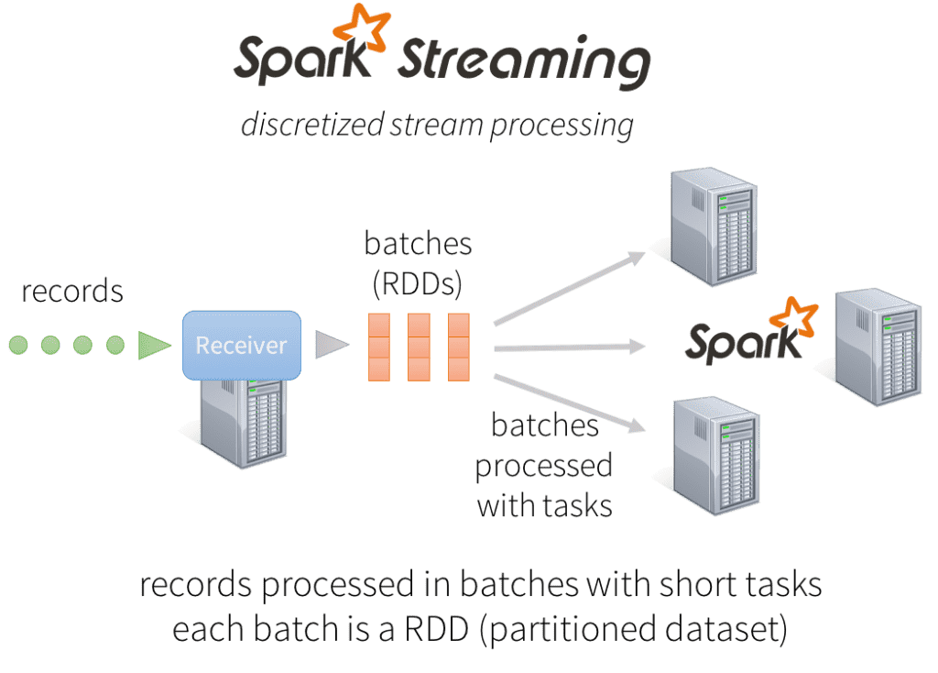
Evolution of the Spark Stream Processing Engine
Record-at-time processing model
Multiple nodes process one record at a time and forwards the generated records to the next machine
Achieves very low latencies
Not efficient at recovering from node failures and straggler nodes (nodes that are slower than others)
Micro-batch Stream Processing (Spark streaming/DStreams)
Continuous series of small map/reduce style batch processing jobs
Sparks task scheduling can very quickly and efficiently recover from failures and straggler executors
Ensures that the output data is the same no matter how many times the task is reexecuted
Latency is larger than record-at-time processing, but advantages outweigh this disadvantage for most use cases
Lack of a single API for batch and stream processing
Lack of separation between logical and physical plans
Lack of native support for event-time windows

Slide 3
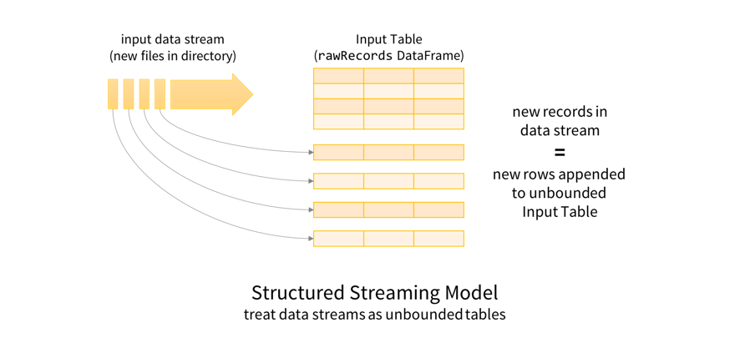
Spark Structured Streaming
Single unified programming model and interface for batch and stream processing
Broader definition of stream processing
Batch and stream are relatively close to being the same idea
Every new record gets appended to an unbound table
Queries built as if this is a static table

Slide 4
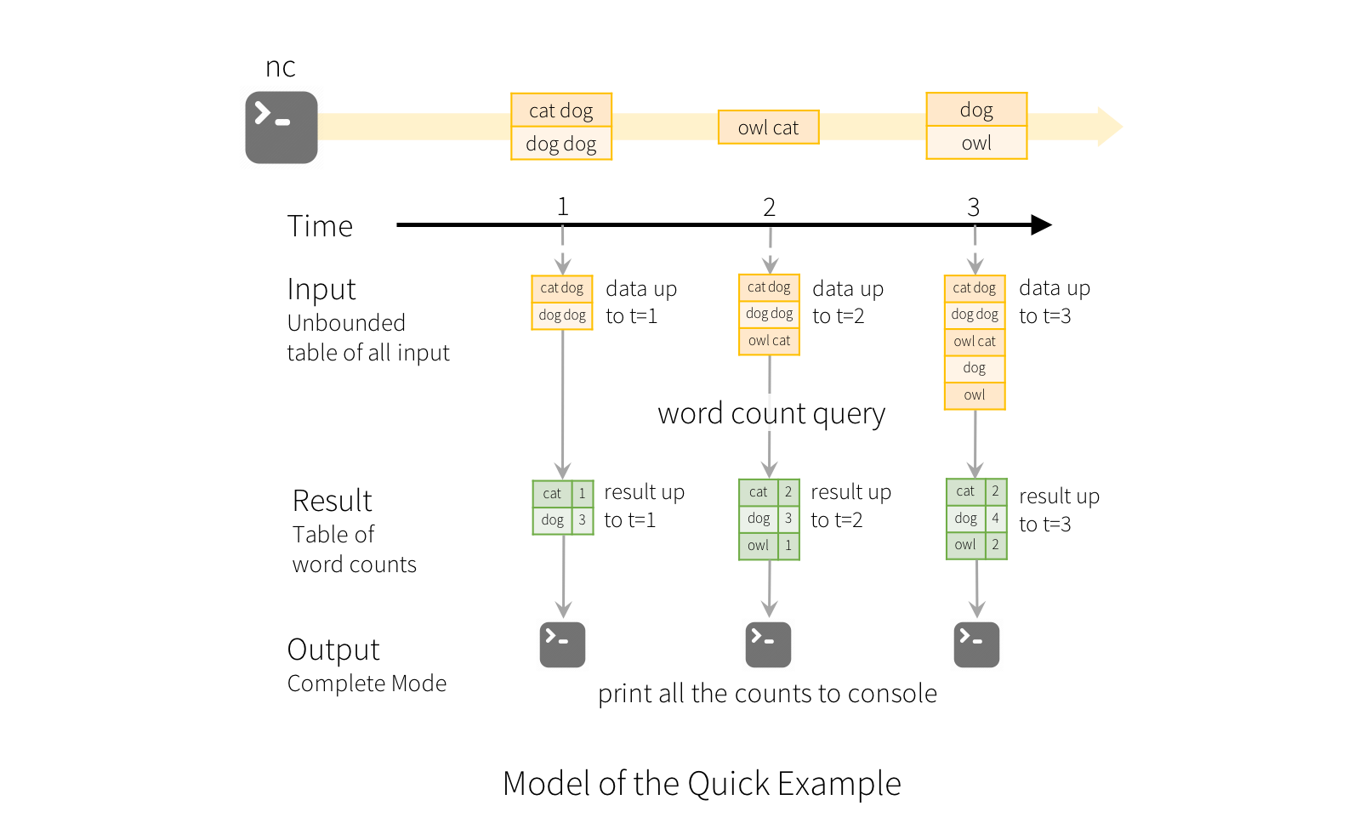
Spark Structured Streaming
Structured Streaming will automatically convert this batch-query to a streaming execution plan (incrementalization)
Output is written incrementally
Append mode – Only the new rows appended to the result table since the last trigger
Update mode – Only the rows that were updated in the result table since the last trigger
Complete mode – The entire updated result table will be written to external storage

Slide 5
Fundamentals (the five steps)
Define Input Sources
spark.readStream
Creates a DataStream.DataStreamReader which has a lot of the same methods as the DataFrameReader
Transform Data
Stateless transformations
select(), filter(), map, etc do not require any information from the previous rows to process the next row
Stateful transformations
Aggregations, counts, windows, etc require the previous state in order to be performed
Some methods are not supported due to complexity
Define Output Sink and Output Mode
Defines how to write the data
Append, complete, update mode
Specify Processing Details
Details on how to process the data
Triggering defines when to trigger the discover and processing of newly available data
Start the Query
Returns the active query

Slide 6
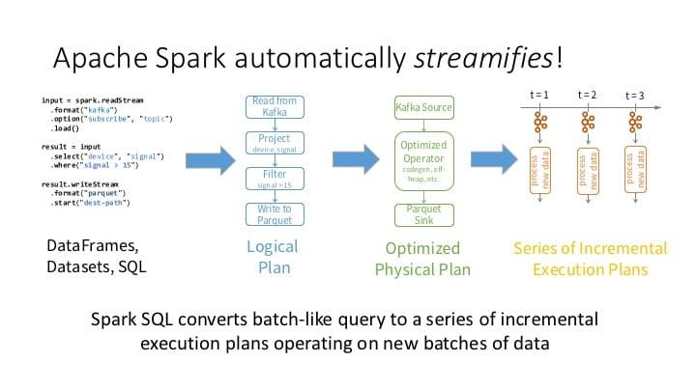

Slide 7
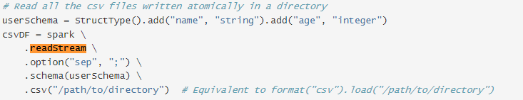
Streaming Files
It is possible to stream files from a directory
For example, you can create a stream to look at a directory and any new files dumped into that directory will be read through the stream.
See our notebook example
Plain text, CSV, JSON, Parquet, ORC, etc. are supported files to be read as a streaming query.
All files must be of the same format and are expected to have the same schema
Violation of this assumption can lead to errors or incorrect parsing
Each file must appear in the directory listing automatically
The entire file must be available at once for reading and then must not be modified.
When there are multiple new files to process it will select the files with the earliest timestamps due to rate limits.

Slide 8

Writing to Files
Structured Streaming supports writing streaming query output to files in the same formats as reads.
Only supports append mode due to complexities in modifying files
Structured Streaming achieves end-to-end exactly-once guarantees when writing to files by maintaining a log of the data files that have been written to the directory.
_spark_metadata
If you change the schema of the result DataFrame between restarts then the output directory will have data in multiple schemas.
Has to be rectified when querying the directory

